Slide 1

Android + Firebase

Slide 2

Ana Coimbra Gomes
Android & Web Dev
@anacoimbrag
ana.coimbra.gomes@gmail.com
(31) 9 9248-2436

Slide 3
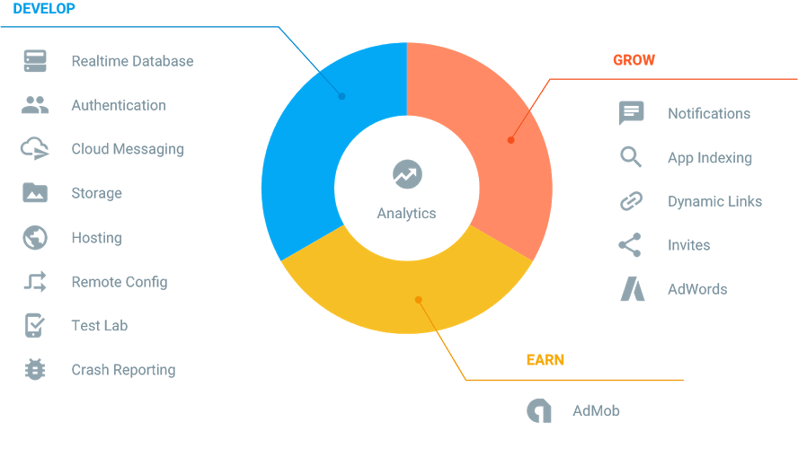
Firebase?

